Slide 1
SWEG2071
Web Design and Programming
SWENG
AASTU
March 2018

Slide 2
Chapter One
Introduction

Slide 3
Objectives
At the end of this chapter, you should be able to:
  Describe Internet and services offered by the Internet
  Differentiate Internet from Web
  Describe different protocols used by the Internet
  Describe the different components of URLs and their purpose
  Identify items required for Internet Programming

Slide 4
Outline
Introduction
World Wide Web
URLs
Hyper Text Transfer Protocol
Webpage Design Tools
  Client Side Scripting HTML, CSS, JavaScript
  Server Side Scripting PHP

Slide 5
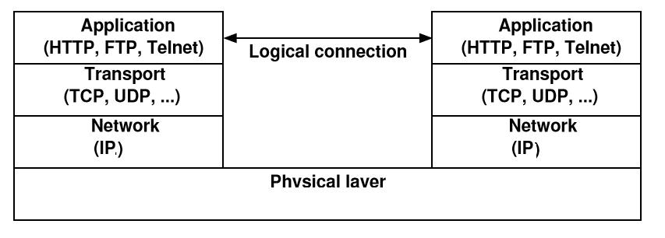
Introduction
A network is a collection of interconnected computers and/or other kinds of equipment
Network Layers

Slide 6
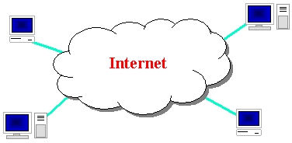
Introduction(cont’d)
Internet
  is short for INTERconnected NETwork
  network of networks
  No centralised (global) control instance
  First version 1969, ARPANET, designed by ARPA, a DoD unit.
  1983 there were 562 computers on the ARPANET, now billions of computers

Slide 7
Introduction(cont’d)
Several Applications
  E-mail
  www
  File transfer (FTP)
  Remote login
  E-commerce
  Streaming video & audio
  Collaboration-Participation (Wiki)
  Social networks
  ….

Slide 8



Organizations
Internet Engineering Task Force (IETF): internet protocol standards
Internet Corporation for Assigned Names and Numbers (ICANN): decides top-level domain names
World Wide Web Consortium (W3C): web standards

Slide 9
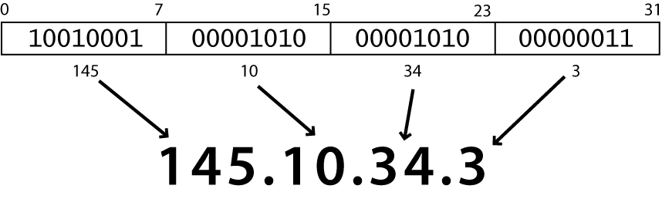
IP Addresses
Each computer must have an IP address before it can connect to the Internet.
Each machine is identified by a unique 4-byte number
IP addresses are normally written as four numbers separated by a period, like this: 213.55.96.152

Slide 10
Domain Name Server
IP-addresses are hard to remember, Names are easier to remember than a 12 digit number
A Domain Name is simply a textual label that corresponds to a numerical IP address.www.google.com is a domain name
When you address a web site, like http://www.google.com, the name is translated to a number by a Domain Name Server (DNS)
When a new domain is registered together with a TCP/IP address, DNS servers all over the world are updated with this information

Slide 11
DNS(cont’d)
DNS name structure
  Hierarchical in nature (eg. sweng.aastu.edu.et)
    sweng is under aastu(a subdomain of aastu), aastu is under edu
  The highest level is the last component of the DNS address
  Labels separated by . (dot)
  Labels can be up to 63 characters long and are case insensitive
  A maximum of 255 characters is allowed in total
The last (highest) labels of a DNS name can be:
  Three letter code top level domains (TLDs): indicating the type of organization
    com, edu, gov, net, org, biz, …
  Two letter country codes (CCTLDs): indicating the country
    et, us, za, uk, …

Slide 12
World Wide Web
The World Wide Web (WWW or Web) is often confused with the Internet. The Web didn’t exist until the 1980s
In 1989 Tim Berners-Lee at CERN created a set of technologies that allowed information on the Internet to be linked together through the use of links, or connections in documents
  http://www.w3.org/History/1989/proposal.html
WWW is one of services running over the Internet
The language used to write these documents with links is HTML-tells browsers how to display the information
The web is “governed” by the w3c (world wide web consortium) (www.w3.org)

Slide 13
World Wide Web
Web Page
  Web page is a document available on world wide web. Web Pages are stored on web server and can be viewed using a web browser.
  A web page can contain huge information including text, graphics, audio, video and hyper links. These hyper links are the link to other web pages.
  Collection of linked web pages on a web server is known as website
A website
  A collection of resources:
    Web pages (static / dynamic)
    Media files (images, animations, sound, …)
    Style files (CSS)
    Documents
  Has a globally unique name
    E.g. www.aastu.edu.et
  Stored on machines called web servers

Slide 14
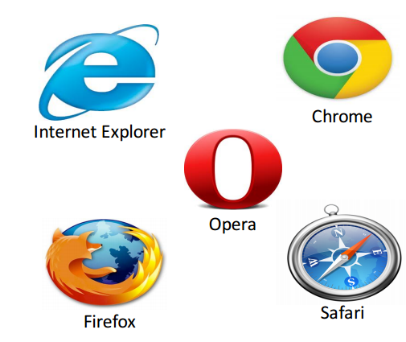
Browsers
Which one do you prefer? Why?

Slide 15
Hypertext
“Non-linear reading and writing”
  embedded links to text in other documents
  allows non-sequential browsing
A page of text
A page of text
A page of text
A page of text
A page of text
A page of text
A page of text
A page of text
A page of text
A page of text
A page of text
A page of text
A page of text
A page of text
A page of text
A page of text

Slide 16
Uniform Resource Locators (URL)
A Uniform Resource Locator (URL) is used to address a document on the Web.
The exact address of a resource on the web
A full Web address is like:
  http://www.scss.tcd.ie/Owen.Conlan/php/xpath/index.html
Format:
  <protocol>://<host>[:<port>][<path>][?<query>]
    E.g. http://www.somedomain.com/search.php?q=dns&lang=en
    Protocol – identifies the type of protocol to be used for communication
      http, ftp, mailto, …
    Host – identifies the machine on which the requested resource is stored
      Computer where information is located.
      It is registered with domain name and associated IP address
        Domain names (eg. www.google.com)
        IP address: 197.156.74.157

Slide 17
URL(cont’d)
    Port – identifies the port number of the web server software on the web server machine
      Communication protocol
        HTTP …….…..uses port No 80
        FTP………..uses port No 21
        Telnet……….23
        DNS………53
        SMTP………25
        https……….443
        ……
    Path – identifies the name and path of the resource on the server
    The path name of the file where info is located
    Query – specifies parameters, if any, that should be sent to the server along with the request
      has the form: ?var_name1=value1&var_name2=value2&…

Slide 18
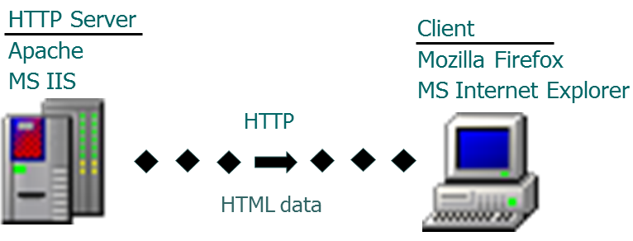
Client-Server Architecture
Client - initiate communication, request for info stored on server
Server- sends that info back to client, reacts

Slide 19
Multipurpose Internet Mail Extensions(MIME)
A browser needs some way of determining the format of a document it receives from a Web server
MIME is used to specify to browser the form of a file returned by server (attached by the server to the beginning of the document)
  different document formats require different rendering tools. E.g. text, image, video, …
Type specifications
  Form: type/subtype
  Examples: text/plain, text/html, image/gif, image/jpeg
  Browser gets the type explicitly from the server

Slide 20
HyperText Transfer Protocol (HTTP)
HTTP is a standard protocol for the communication between a web server and a web client (web browser)
Used to deliver all files and other data (collectively called resources) on the World Wide Web, whether they're HTML files, image files, query results, or anything else.
Consists of two phases: Request and response. Each has two parts:
  header contains information about the communication;
  body contains the data of the communication if there is any
1. Request Phase Form:
  HTTP method /path-to- resource HTTP/version-no
  Request Header fields
  blank line
  Message body
a) An example of the first line of a request:
  GET /cs.uccp.edu/degrees.html HTTP/1.1

Slide 21
HTTP Request(cont’d)
Request method:
  GET- retrieves information from a server, such as an HTML document, an image or search results based on a user-submitted search term
  POST - sends data to a server.
    E.g. Send form data to server
  HEAD – like GET but only returns meta-information
    E.g.: if the browser wants to know the last modified data of a web page it would use the head command.
  PUT: it is the opposite of get command. It sends a file to the server for storing it there.
  DELETE (information) from the server
    This command allows a browser to send an http request for deleting a particular web page

Slide 22
HTTP Request(cont’d)
b) header fields:
Format: fieldname: value_of_field
The header fields can be:
  General headers: for general info, e.g. date
  Request headers: info about browser, in request headers
  Response headers: information about the server, for response headers
  Entity headers: meta-information, used in both request & response headers
Common request fields:
  Host: host name (specify host name, for HTTP 1.1)
  Accept: text/plain (specify MIME type)
  Accept: text/*
Common response fields:
  Content-length: 488
  Content-type: text/html
The order of the header field is insignificant

Slide 23
HTTP Request(cont’d)
c) blank line
  Separate the header from the body of the request.
  Requests that use the GET, HEAD, and DELETE methods do not have bodies. In these cases, the blank line signals the end of the request .

Slide 24
HTTP Request(cont’d)
d) Message Body
  Used to carry an entity body
  May be divided into chunks and sent
  Optional, some cannot even have a message body
  Example of message body: A web page

Slide 25
HTTP Response(cont’d)
2. Response Phase Form
  Status line: includes HTTP version used, status code for the response, and short explanation of status code
  Response header fields: contain several lines of information about the response. The essential field of the header is Content-type.
  Blank line
  Response body
  A practical exercise: simulating the browser
  At a command prompt
    telnet www.aastu.du.et 80 (enter)
    HEAD / HTTP/1.0 (enter twice)

Slide 26
HTTP Response - Example
HTTP/1.1 200 ok
Server: Microsoft-IIS/5.0
Content-Type: text/html
Accept-Ranges: bytes
Last-Modified: Tue, 13 Aug 2007 09:34:22 GMT
Content-Length: 240
<html><head><title>page titile</title></head>
<body>some content</body></html>

Slide 27
HTTP Response(cont’d)
The status code is a three-digit integer, and the first digit identifies the general category of response:
  1xx indicates an informational message only
  2xx indicates success of some kind
  3xx redirects the client to another URL
  4xx indicates an error on the client's part
  5xx indicates an error on the server's part
The most common status codes are:
  200 OK The request succeeded, and the resulting resource (e.g. file or script output) is returned in the message body.
  301 Moved Permanently
  302 Moved Temporarily
  303 See Other (HTTP 1.1 only) The resource has moved to another URL (given by the Location: response header), and should be automatically retrieved by the client.
  404 Not Found The requested resource doesn't exist.
  500 Server Error An unexpected server error. The most common cause is a server-side script that has bad syntax, fails, or otherwise can't run correctly.

Slide 28
HTTP Response (cont’d)
  1xx – request received, processing continues
    E.g.
      100 Continue – tells client to continue with a request
  2xx – success, action was successfully received, understood and accepted
    E.g.
      200 Ok – request has succeeded
      202 Accepted – request accepted but not processed
  3xx – further action must be taken to complete the request
    E.g.
      302 Found – resource found but temporarily moved

Slide 29
HTTP Response (cont’d)
  4xx – client error or invalid request
    E.g.
      400 Bad Request – couldn’t understand request
      401 Unauthorized – request requires authorization
      403 Forbidden – client may not have access to the resource
  5xx – server error occurred
    E.g.
      500 Internal Server Error – server encountered an unexpected error (error/bug with a server side script)
      505 HTTP Version Not Supported – server doesn’t support the HTTP version

Slide 30
Website Designing Tools
Hypertext Markup Language (HTML): define the content of web pages
Cascading Style Sheets (CSS): stylistic info for web pages
JavaScript: to program the behavior of web pages
Hypertext Processor (PHP): dynamically create pages on a web server
Structured Query Language (SQL): interaction with databases

Slide 31
Reading Assignment
Identify standards provided by IETF and W3C
URI and URL
HTTP Vs HTTPS

Slide 32
Next Class
Submission of Project Title with brief description
Chapter Two: HTML

